Slide 1
The Two Generals Problem
Lecturer: Ngo Huy Bien
Software Engineering Department
Faculty of Information Technology
VNUHCM - University of Science
Ho Chi Minh City, Vietnam
nhbien@fit.hcmus.edu.vn

Slide 2

Objectives

Slide 3

Contents

Slide 4

References
E. A. Akkoyunlu et al. (1975). Some constraints and tradeoffs in the design of network communications.

Slide 5
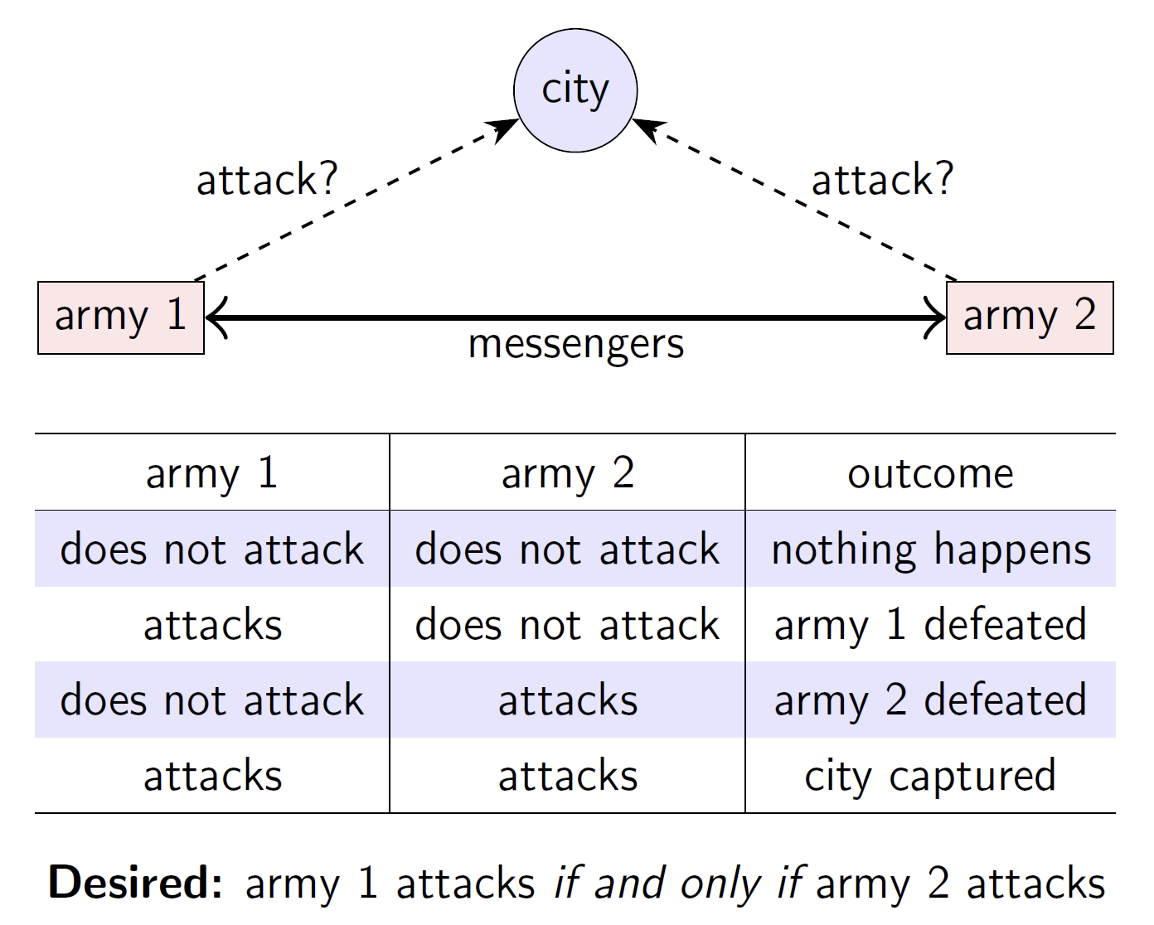
The Two Generals Problem

Slide 6
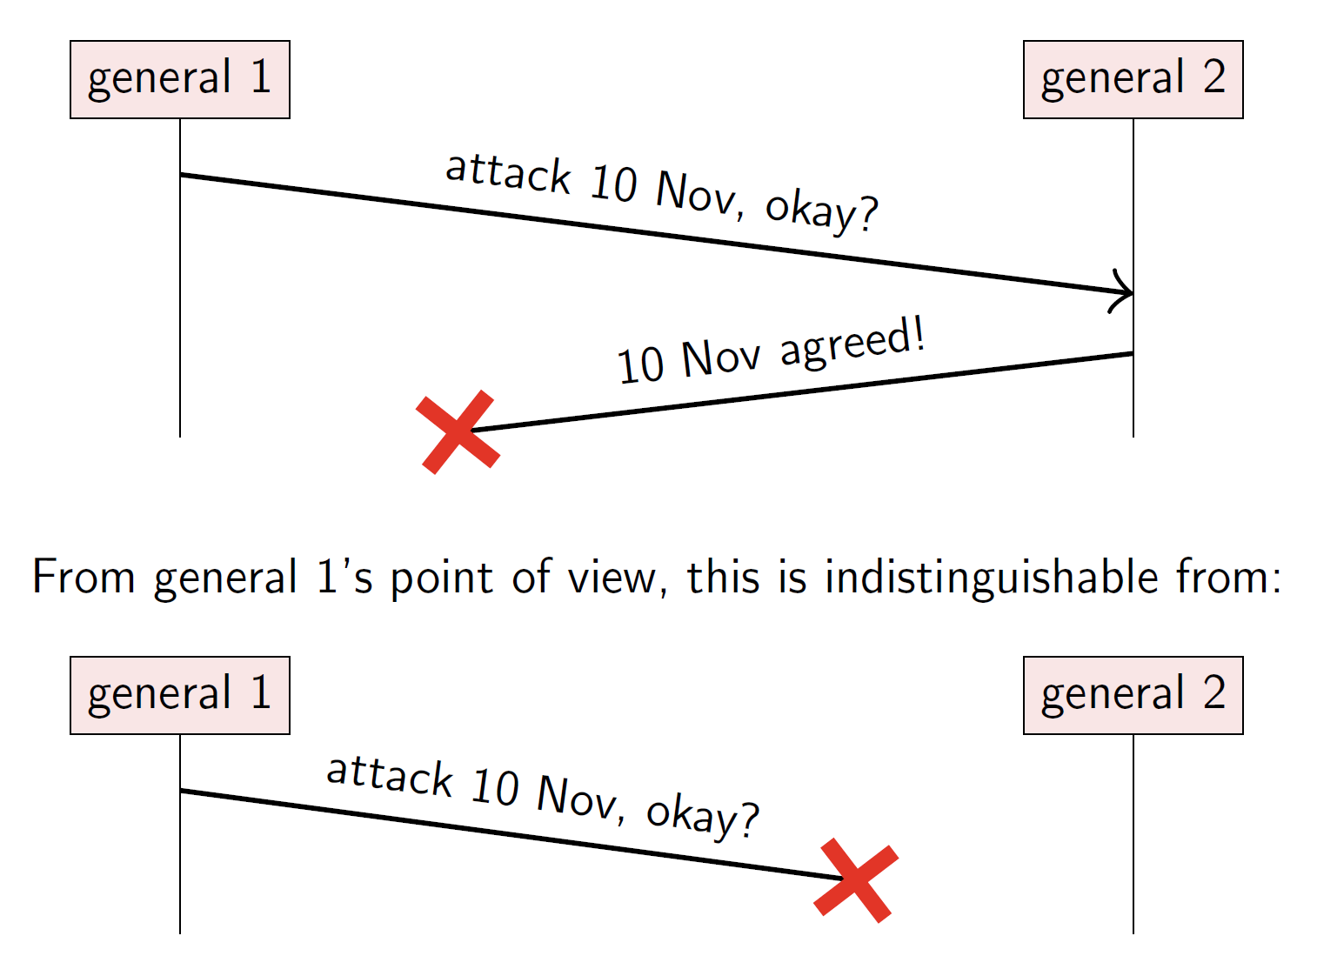
Messages Lost
What protocol should the two generals use to agree on a plan?

Slide 7
How Should the Generals Decide?
General 1 always attacks, even if no response is received?
Send lots of messengers to increase probability that one will get through
If all are captured, general 2 does not know about the attack, so general 1 loses
General 1 only attacks if positive response from general 2 is received?
Now general 1 is safe
But general 2 knows that general 1 will only attack if general 2’s response gets through
Now general 2 is in the same situation as general 1 in option 1
The problem is that no matter how many messages are exchanged, neither general can ever be certain that the other army will also turn up at the same time.

Slide 8


Slide 9
Formal Description [1]
https://mwhittaker.github.io/blog/two_generals_and_time_machines/
We'll label Alice and Bob A and B. Each general has a state, q, from some state set Q. Each general also has an outbox and inbox which can hold exactly one enveloped message to send or receive respectively.
A configuration is the pair of Alice and Bob's states (q_{a},q_{b}).

Slide 10
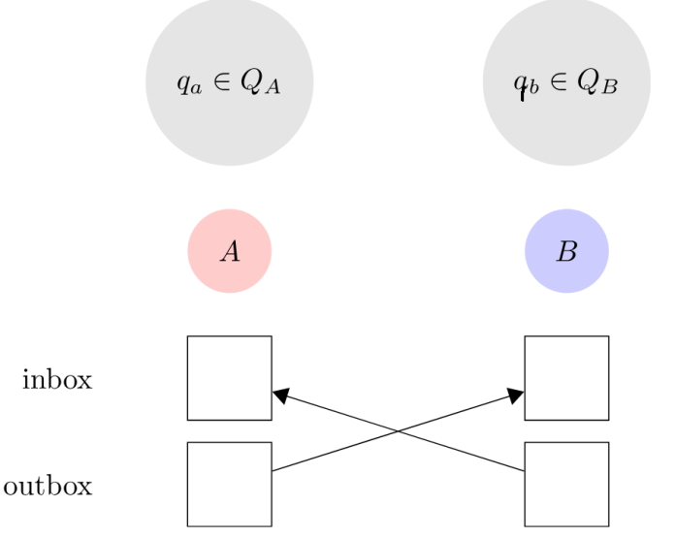
Delivery Events
The system can changes with two events. In a delivery event, the message in each general's outbox is potentially moved to the other general's inbox. Eve decides whether the message is delivered or burned. For the sake of simplicity, we'll assume that both generals always have an envelope in their outbox to send. If they don't have any meaningful message then they place an empty envelope in their outbox.

Slide 11
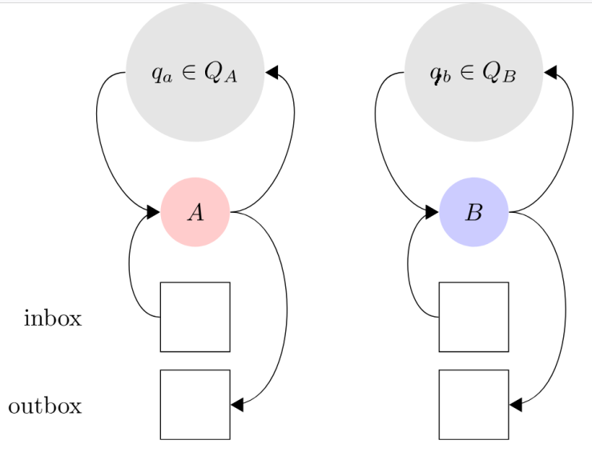
Computation Events
In a computation event, a general updates its state and places a message in its outbox based on the message in its inbox and its current state. More formally, each process has a transition function, f:Inbox×Q→Q×Outbox, that maps an inbox message and the current state to a new state and outbox message.

Slide 12
Executions
An execution is a sequence of alternating configurations and rounds of events denoted (C0,ϕ1,C1,ϕ2,…). Each Ci is a configuration and each ϕiis a round of events where each general performs a computation event and then a delivery event.
An execution E1 is indistinguishable to another execution E2 for a general g if g sees the same thing in both executions. For example, consider a pair of executions with a single round of events with generals A and B: (C0,ϕ1,C1) and (C′0,ϕ′1,C′1). In ϕ1, A's enveloped message is delivered, but in ϕ′1, it is not. Both executions are indistinguishable to A because she cannot tell if her message was delivered or not. These executions are not indistinguishable for B who can tell in round three whether or not the message was delivered. Note that if E1 and E2 are indistinguishable for g, then g performs the same actions in E1 and E2.

Slide 13
Protocol Requirements
The requirements for the protocol are that, in all executions:
Agreement: All processes output the same decision (0 or 1).
Validity:
If all processes have the same input 1, and no messages are lost, all processes produce output 1.
If all processes have the same input 0, and no messages are lost, all processes produce output 0.
If processes start with different inputs, processes can output 0 or 1 as long as they all agree.
If one or more messages are lost, processes can output 0 or 1 as long as they all agree.
Termination: All processes terminate in a bounded number of rounds.

Slide 14
Indistinguishability Proof
The key steps of an indistinguishability proof usually look like this:
Show that execution A is indistinguishable from execution B for some process p, meaning that p sees the same things (messages or operation results) in both executions.
Observe that if A is indistinguishable from B for p, then because p can’t tell which of these two possible worlds it is in, it returns the same output in both.

Slide 15
Impossibility Proof (I)
Assume for contradiction that there does exist an algorithm that satisfies these two properties. I'll play the part of Eve and construct a contradiction. I'll do so with a time machine.
First, I'll start Alice and Bob with 1's as input. I'll allow all messages to be delivered and wait all N rounds. By the validity condition, we know that Alice and Bob both output 1. Call this execution E1.
Next, I'll fire up my time machine and go back one round into the past. I'll keep everything the same except this time I'll burn Alice's last message to Bob. Note that I burn the message without opening the envelope and reading the message. Call this execution E2. E1 is indistinguishable to E2 for Alice. Thus, she must perform the same action in E1 and E2. This means Alice must again output 1. By the agreement condition, this means that Bob must also output 1.

Slide 16
Impossibility Proof (II)
I'll fire up my time machine and again keep everything the same as in E2, except this time I'll burn Bob's last message to Alice. Call this execution E3. E2 is indistinguishable to E3 for Bob, so by a symmetric argument as above, Bob and Alice both output 1.
I'll continue my time machine antics until I've dropped every messages. Alice and Bob still begin with 1's as input and still output 1 after N rounds. Call this execution Ek.
With the help of my time machine, I'll switch Alice's input from 1 to 0. This execution, Ek+1, is indistinguishable to Ek for Alice, so she still outputs 1, as does Bob. Next, I'll switch Bob's input to 0. Again, this execution, Ek+2, is indistinguishable to the previous execution, Ek+1, for Bob, so both Bob and Alice output 1.

Slide 17
Impossibility Proof (III)
Now that both Alice and Bob begin with an input of 0, I'll use my time machine and deliver the first message of Bob's. Then I'll deliver the first message of Alice's. I'll continue this procedure until I reach round Nand all messages are delivered. Note that these messages may not be the same messages I previously burned.
Now, all messages are delivered and both Alice and Bob begin with 0 as input. However, Alice and Bob still output 1! This violates the validity condition and is a contradiction.

Slide 18

Thank You & See You Again

